Slide 1
Introduction To Compiler
Course Code: CSC 3220
Course Title: Compiler Design
Dept. of Computer Science
Faculty of Science and Technology
Lecturer No: |  | Week No: | 1 | Semester: | Summer 23-24
Lecturer: | Nazia Alfaz; nazia.alfaz@aiub.edu Room: D0201B

Slide 2
Lecture Outline
Vision, Mission, Quality Policy, and Goals of AIUB
Vision and Mission of Computer Science Department
Course Evaluation
Objective of this Course
Basic things of a Compiler
Language Processors

Slide 3
Vision
AMERICAN INTERNATIONAL UNIVERSITY-BANGLADESH (AIUB) envisions promoting professionals and excellent leadership catering to the technological progress and development needs of the country.

Slide 4
Mission
AMERICAN INTERNATIONAL UNIVERSITY-BANGLADESH (AIUB) is committed to provide quality and excellent computer-based academic programs responsive to the emerging challenges of the time. It is dedicated to nurture and produce competent world class professional imbued with strong sense of ethical values ready to face the competitive world of arts, business, science, social science and technology.

Slide 5
Quality Policy
“Quality shall be adhered to in conformity with the prescribed national and international standards of quality and excellence including those provided by the professional bodies and organizations. The American International University- Bangladesh is committed to translate into actions the programs, projects and activities related to the sustainable delivery of quality management operation system. The students being the valued customers are the central focus of the university shall be provided with utmost care and attention to meet their primordial needs and future career success. In view of this commitment, the university shall exert best efforts to harmonize its action through collaboration, cooperation and consultation with every unit and components of the university.”

Slide 6
Goals
Sustain development and progress of the university
Continue to upgrade educational services and facilities responsive
of the demands for change and needs of the society
Inculcate professional culture among management, faculty and
personnel in the attainment of the institution's vision, mission and goals
Enhance research consciousness in discovering new dimensions for curriculum development and enrichment
Implement meaningful and relevant community outreach programs reflective of the available resources and expertise of the university
Establish strong networking of programs, sharing of resources and expertise
with local and international educational institutions and organizations
Accelerate the participation of alumni, students and professionals in the implementation of educational programs and development of projects designed to expand and improve global academic standards

Slide 7
Vision of Computer Science Department
Our vision is to be the preeminent Department of Computer Science through creating recognized professionals who will provide innovative solutions by leveraging contemporary research methods and development techniques of computing that is in line with the national and global context.

Slide 8
Mission of Computer Science Department
The mission of the Department of Computer Science of AIUB is to educate students in a student-centric dynamic learning environment; to provide advanced facilities for conducting innovative research and development to meet the challenges of the modern era of computing, and to motivate them towards a life-long learning process.

Slide 9
Objectives and Outcomes
Objectives:
Understand the objective of this Course
Understand the basic concept of a compiler
Outcomes:
Students should be able to understand the importance of a compiler
Students will analyze the language Processors.

Slide 10
Basic things of a Compiler
What is a Compiler?
Why do we need a compiler?
Why study compilers?

Slide 11
Basic things of a Compiler
Compilers Construction touches many topics in Computer Science
Theory
Finite State Automata, Grammars and Parsing, data-flow
Algorithms
Graph manipulation, dynamic programming
Data structures
Symbol tables, abstract syntax trees
Software Engineering
Software development environments, debugging
Artificial Intelligence
Heuristic based search

Slide 12
Language processors
Some common language processors are:
Compiler
Interpreter
Preprocessor
Assembler

Slide 13
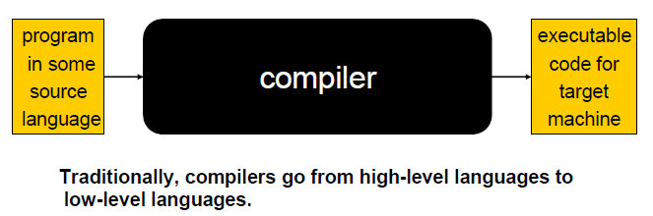
Compiler
A compiler is a program that reads a program written in one language and translates it into another language.

Slide 14
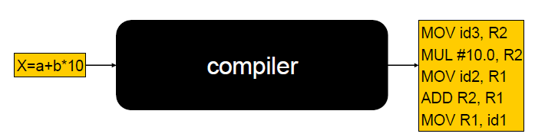
Example
MOV R1, id3
MUL R1, #10
MOV R2, id2
ADD R1, R2
MOV R3,id1
MOV R3, R1

Slide 15
Interpreter
An interpreter is another common kind of language processor. Instead of producing a target program as a translation, an interpreter appears to directly execute the operations specified in the source program on inputs supplied by the user.
Source
Program
Interpreter

Slide 16
Preprocessor
Preprocessing performs (usually simple) operations on the source file(s) prior to compilation.
Source file inclusion
#include<stdio.h> will be replaced by the original implementation of stdio.h file. It will remove the #include statement from the source code and includes stdio.h file content into the source program.
Macro expansion
#define size 10. Here size is a macro which holds the value 10. Before the compilation starts, the preprocessor will replace size by 10 all over the program.
Conditional compilation
We can decide which part of the source program should compile and which part should be ignored during compilation. #if, #else, #elseif, #endif

Slide 17
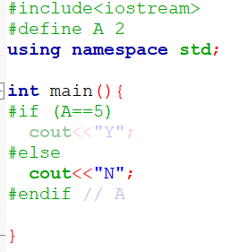
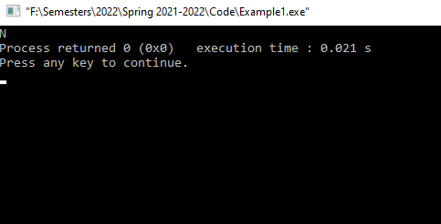

Slide 18
Assembler
An Assembler is a translator that translates Assembly language to machine code. So, an assembler is a type of a compiler and the source code is written in Assembly language.
Assembly
Program
Assembler

Slide 19
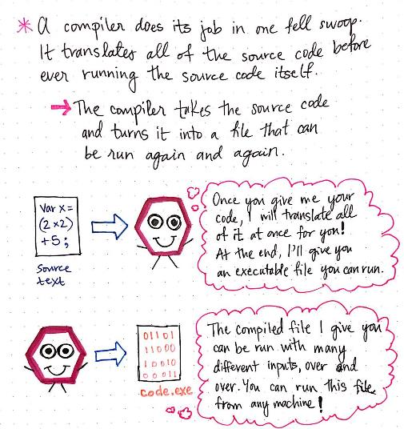
Compiler

Slide 20
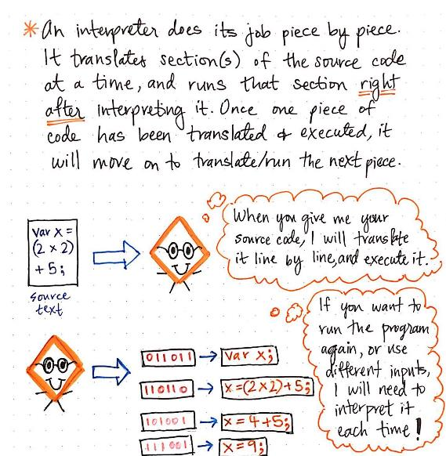
Interpreter

Slide 21
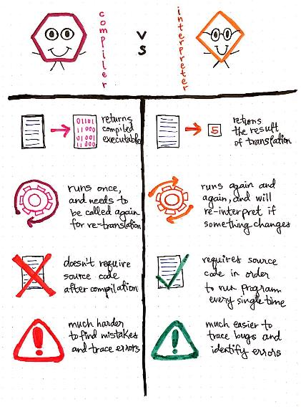
Differences between Compiler and Interpreter

Slide 22
Differences between Compiler and Interpreter
Compiler | Interpreter
Compiler takes whole program as input. | Interpreter takes single instruction as input.
Intermediate Object code is generated. | No Intermediate Object Code is Generated
Memory Requirement: More | Memory Requirement is Less
Program need not be compiled every time . | Every time higher level program Is converted into lower level program.
No memory is required during execution | Memory is required during execution

Slide 23
Lecture References
A. Aho, R. Sethi and J. Ullman, Compilers: Principles, Techniques and Tools
(The Dragon Book), [ Second Edition]

Slide 24
References
A. Aho, R. Sethi and J. Ullman, Compilers: Principles, Techniques and Tools(The Dragon Book), [ Second Edition]
Principles of Compiler Design (2nd Revised Edition 2009) A. A. Puntambekar
Basics of Compiler Design Torben Mogensen

